Slide 1
Arhitecturi Paralele Memoria Cache
Dr. Ing. Cristian Chilipirea – cristian.chilipirea@gmail.ro

Slide 3
Ierarhia de memorii
 | Capacitate | Latență | Cost/GB | Controlat de
Regiștri | x 1 B | 1ns < | - | Compilator
Cache (SRAM) | x 10MB | 1-10ns | $5000 | Hardware
RAM (DRAM) | x 100GB | 70-100ns | $50 | Hardware/Kernel
SSD (Flash) | x 1TB | 7-150µs | $1 | Kernel
HDD (Magnetic) | x 19TB | 1-10ms | $0.1 | Kernel

Slide 4
Principiul “locality”
Dacă avem un acces asupra unei date de la locația X, un acces la locația X+ΔX la un moment de timp t+Δt devine mai probabil cu cât ΔX și Δt se apropie de 0.
Localitate spațială: Două zone de memorie apropiate vor fi accesate la un interval de timp apropiat.
Localitate temporală: Dacă o zonă de memorie e accesată, sunt șanse mari să fie accesată din nou.

Slide 5
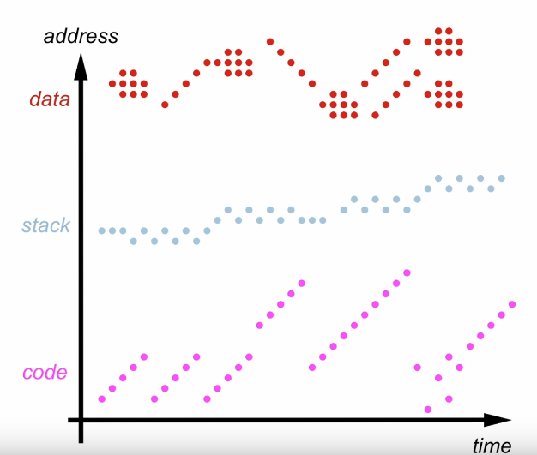
Pattern acces la memorie
Notes:
https://www.youtube.com/watch?v=M-ZgVhzvh24

Slide 6
Utilizare
RAM
DataA
Get A
DataB
CPU
Cache

Slide 7
Utilizare
RAM
DataA
Get A
DataB
CPU
Cache

Slide 8
Utilizare
RAM
DataA
DataB
CPU
Cache
DataA

Slide 9
Utilizare
RAM
DataA
DataB
CPU
Cache
DataA

Slide 10
Utilizare
RAM
DataA
DataB
CPU
Cache
DataA
DataA

Slide 11
Utilizare
RAM
DataA
DataB
CPU
Cache
DataA

Slide 12
Utilizare – Cache Hit
RAM
DataA
Get A
DataB
CPU
Cache
DataA

Slide 13
Utilizare – Cache Hit
RAM
DataA
DataB
CPU
Cache
DataA
DataA

Slide 14
Utilizare
RAM
DataA
DataB
CPU
Cache
DataA

Slide 15
Utilizare – Cache Miss
RAM
DataA
Get B
DataB
CPU
Cache
DataA

Slide 16
Utilizare – Cache Miss
RAM
DataA
Get B
DataB
CPU
Cache
DataA

Slide 17
Utilizare – Cache Miss
RAM
DataA
DataB
CPU
Cache
DataA
DataB

Slide 18
Utilizare – Cache Miss
RAM
DataA
DataB
CPU
Cache
DataB

Slide 19
Utilizare – Cache Miss
RAM
DataA
DataB
CPU
Cache
DataB
DataB

Slide 20
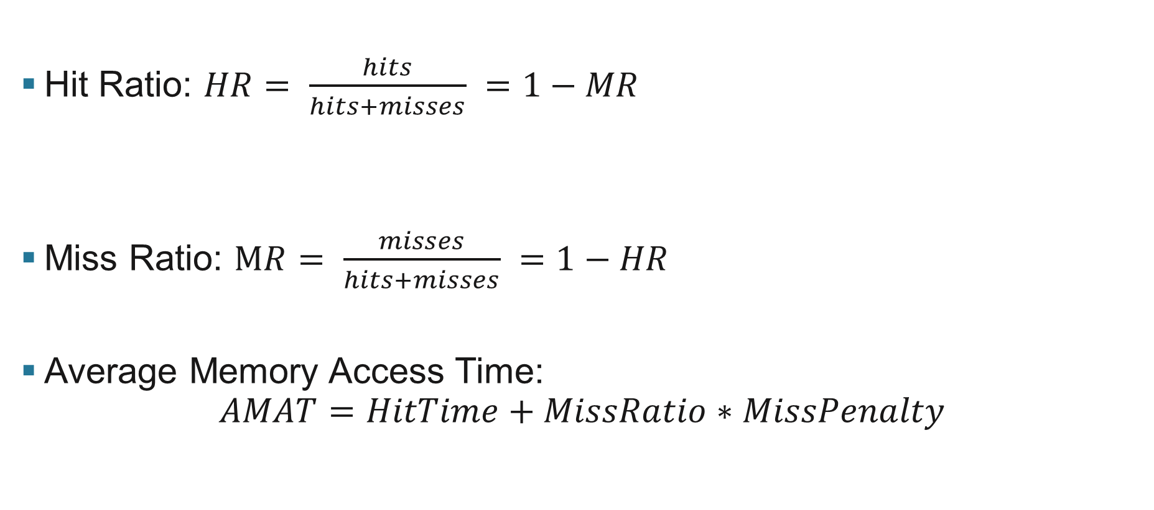
Hit/Miss Ratio
Hit Ratio: $HR= \frac{hits}{hits+misses} =1−MR$
Miss Ratio: $MR= \frac{misses}{hits+misses} =1−HR$
Average Memory Access Time:
$$AMAT=HitTime+MissRatio∗MissPenalty$$

Slide 21
Direct-Mapped Cache
Valid bit
Tag (40 bits)
Data (64 byte - lines)
 |  |  | ...
 |  |  | ...
 |  |  | ...
 |  |  | ...
 |  |  | ...
 |  |  | ...
 |  |  | ...
 |  |  | ...
Tag bits (40)
Index bits (18)
Offset bits (6)
 |  |  |  |  |  |  |  |  |  |  |  |  |  |  |  |  |  |  |  | ...

Slide 22
Problemă: Cache Thrashing
 |  |  |  |  |  |  |  |  |  |  |  |  |  |  |  |  |  |  |  | ... | 0 | 1 | 0 | 0 | 0 | 0 | 0 | 0 | 0 | 0 | 0 | 0 | 0 | 0 | 0 | 0 | 0 | 0 | 0 | 0 | 0 | 0 | 0 | 0 | 0
 |  |  |  |  |  |  |  |  |  |  |  |  |  |  |  |  |  |  |  | ... | 0 | 1 | 0 | 0 | 0 | 0 | 0 | 0 | 0 | 0 | 0 | 0 | 0 | 0 | 0 | 0 | 0 | 0 | 0 | 0 | 0 | 0 | 0 | 0 | 1
 |  |  |  |  |  |  |  |  |  |  |  |  |  |  |  |  |  |  |  | ... | 0 | 1 | 0 | 0 | 0 | 0 | 0 | 0 | 0 | 0 | 0 | 0 | 0 | 0 | 0 | 0 | 0 | 0 | 0 | 0 | 0 | 0 | 0 | 1 | 0
Se vor scrie în aceeași zonă din Cache
 |  |  |  |  |  |  |  |  |  |  |  |  |  |  |  |  |  |  |  | ... | 1 | 1 | 0 | 0 | 0 | 0 | 0 | 0 | 0 | 0 | 0 | 0 | 0 | 0 | 0 | 0 | 0 | 0 | 0 | 0 | 0 | 0 | 0 | 0 | 0
 |  |  |  |  |  |  |  |  |  |  |  |  |  |  |  |  |  |  |  | ... | 1 | 1 | 0 | 0 | 0 | 0 | 0 | 0 | 0 | 0 | 0 | 0 | 0 | 0 | 0 | 0 | 0 | 0 | 0 | 0 | 0 | 0 | 0 | 0 | 1
 |  |  |  |  |  |  |  |  |  |  |  |  |  |  |  |  |  |  |  | ... | 1 | 1 | 0 | 0 | 0 | 0 | 0 | 0 | 0 | 0 | 0 | 0 | 0 | 0 | 0 | 0 | 0 | 0 | 0 | 0 | 0 | 0 | 0 | 1 | 0

Slide 23
Matrici - Utilizare Cache Bună

Slide 24
Matrici - Utilizare Cache Rea

Slide 25
Fully-Associative Cache
Valid bit
Tag (58 bits)
Data (64 byte - lines)
 |  |  | ...
 |  |  | ...
 |  |  | ...
 |  |  | ...
 |  |  | ...
 |  |  | ...
 |  |  | ...
 |  |  | ...
Tag bits (58)
Offset bits (6)
 |  |  |  |  |  |  |  |  |  |  |  |  |  |  |  |  |  |  |  | ...

Slide 26
N (20) Way-Associative Cache
Tag (45 bits)
Data (64 byte - lines)
Tag (45 bits)
Data (64 byte - lines)
Tag (45 bits)
Data (64 byte - lines)
 |  |  | ...
 |  |  | ...
 |  |  | ...
 |  |  | ...
 |  |  | ...
 |  |  | ...
 |  |  | ...
 |  |  | ...
 |  |  | ...
 |  |  | ...
 |  |  | ...
 |  |  | ...
 |  |  | ...
 |  |  | ...
 |  |  | ...
 |  |  | ...
 |  |  | ...
 |  |  | ...
 |  |  | ...
 |  |  | ...
 |  |  | ...
 |  |  | ...
 |  |  | ...
 |  |  | ...
...
Tag bits (45)
Index bits (13)
Offset bits (6)
 |  |  |  |  |  |  |  |  |  |  |  |  |  |  |  |  |  |  |  | ...

Slide 27
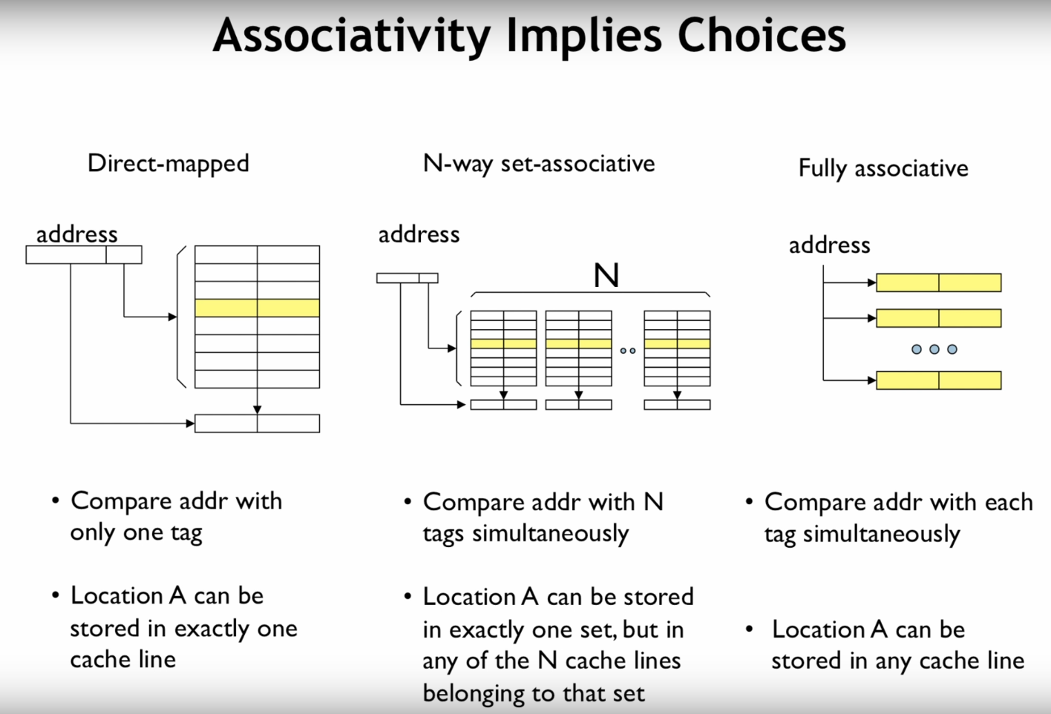
Notes:
https://www.youtube.com/watch?v=q30W7ApRqjI&t=3s

Slide 28
Cache replacement policies
Random
FIFO/LIFO
Least Recently Used/Most recently used
Least Frequently Used <<<<< LRU approximations
Bélády (clairvoyant)

Slide 29
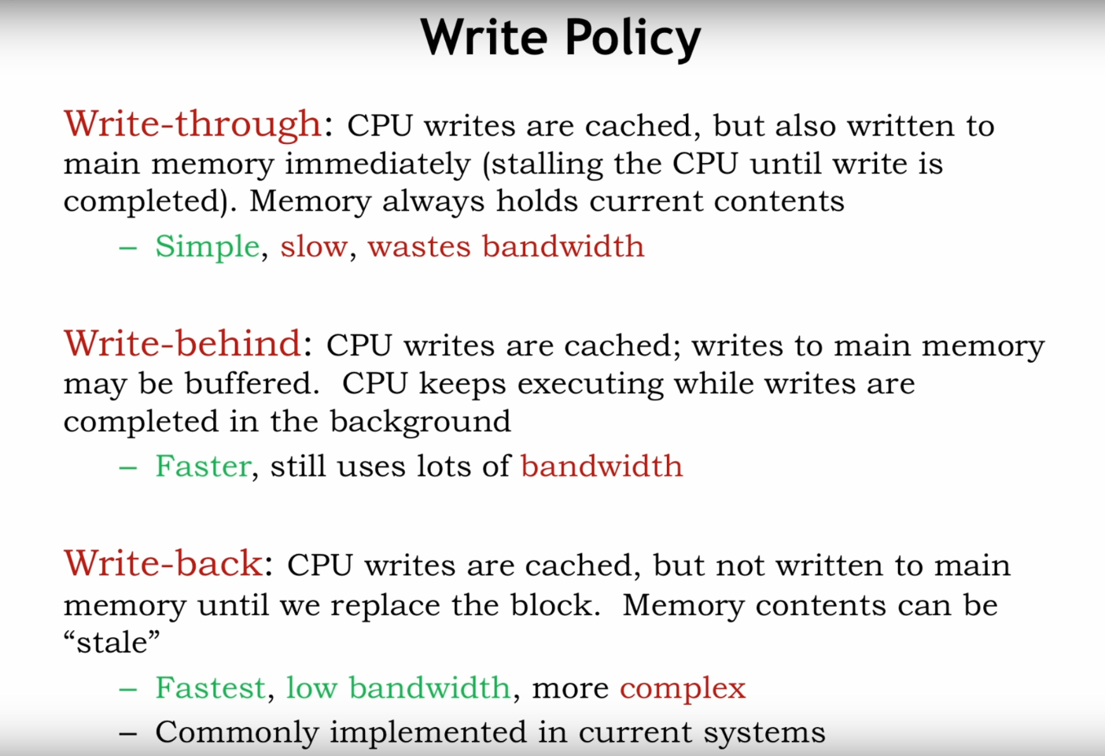

Slide 31
False sharing
Get 1
CPU
Cache
Data1
RAM
CPU
Cache
CPU
Set 1
Cache
Data1

Slide 32
False sharing – gets worse – cache lines
Get 1 [6]
CPU
Cache
Data1
RAM
CPU
Cache
CPU
Set 1 [3]
Cache
Data1

Slide 33
False sharing
Get 1
CPU
Cache
Data1
RAM
Cache coherency
CPU
Cache
CPU
Set 1
Cache
Data1

